Slide 1

Machine Learning Algorithms and Computational Tools Development for Analysis of Sequencing and EMR Data
Shaopeng Gu
Department of Mathematics & Statistics
Oct 30th, 2019

Slide 2
Outlines
Chapter 1
Introduction
Next-Generation Sequencing Data
Chapter 2
Tools Development
Sequencing Data Analysis
Chapter 3
Collaborative Efforts
GeneQC
EMR Data
Machine Learning for Data Analysis
EMR Data Analysis
Chapter 4
Glycine Max RNA sequencing Analysis
Discussion

Slide 3
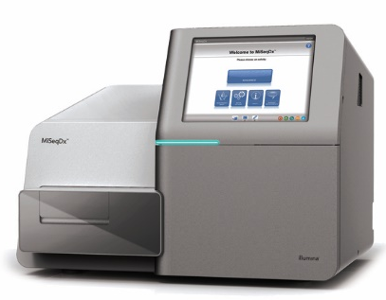
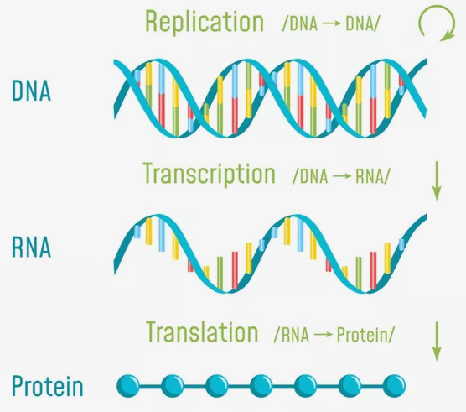
Next-Generation Sequencing (NGS) Data
Friendly Cost
High Speed
High Resolution and Accuracy
Explosive Growth of DNA and RNA Sequencing (200 million in NCBI GenBank)

Slide 4

Electronic Medical Record (EMR) Data
EMR Stores Longitudinal Health Information
Treatment history
Medical history
A Comprehensive Picture of A Patient’s Medical History

Slide 5
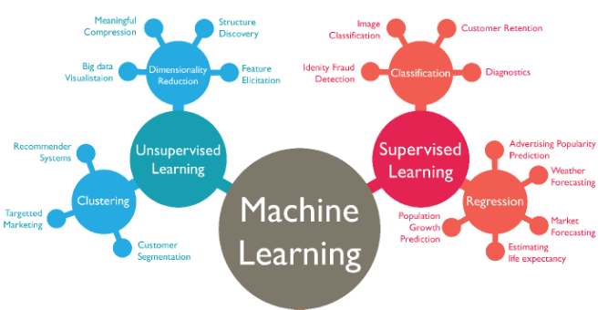
Machine Learning
Supervised Learning
Classification and regression
Unsupervised Learning
Clustering and dimensionality reduction
Reinforcement Learning

Slide 6
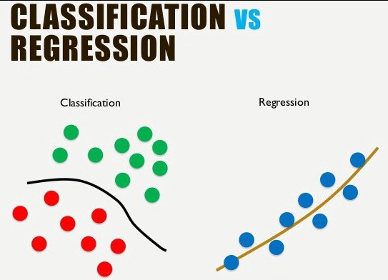
Machine Learning in Data Analysis
Analysis of Biological Sequencing
Structural properties prediction
Functional properties prediction
Drug target development
Fold recognition, etc.
Analysis of EMR Data
Health estimation
Disease prediction
Treatment aid, etc.

Slide 7
Tool Development for Sequencing Data Analysis
Computational Tools are Urgently Needed Because:
Gap exists between sequencing data and their functional annotation (0.3%)
Sequencing data cannot be analyzed by human inspection
High cost of wet laboratory experiment
A Comprehensive Sequencing Data Pipeline Tool should:
Covert original sequencing data (Fast) to mathematical matrix for predicting
Accurately and fast implement prediction
Integrate most popular and recent predictors
User-friendly and memory efficient

Slide 8
Overall Designing Idea of Pipeline Tool
Comprehensive Sequencing Data Analysis Tool
Feature
Extraction
Feature Selection or Dimensionality Reduction
Predicting Models Construction
Seq Data
Label

Slide 9
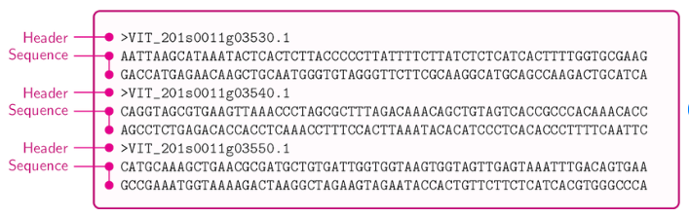
Feature Extraction
Transforming Sequencing Data into mathematical expression
Sequencing property
Physicochemical property
Evolution
Structure

Slide 10
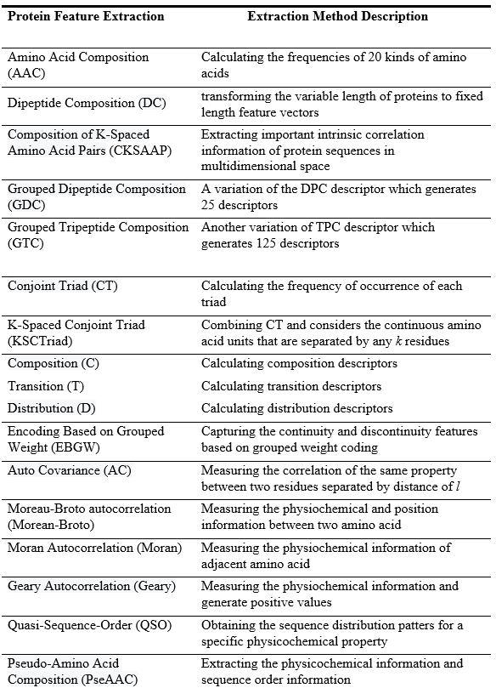
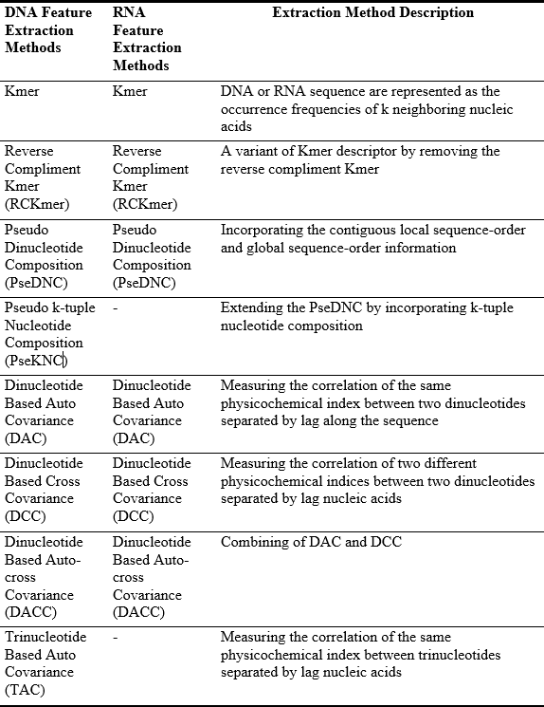
Feature Extraction Methods
16 DNA Feature Extraction Methods
12 RNA Feature Extraction Methods
32 Protein Feature Extraction Methods

Slide 11
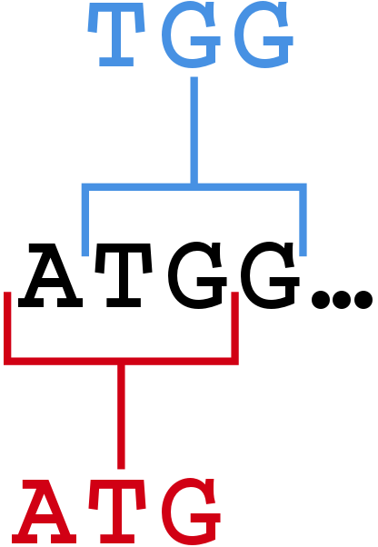
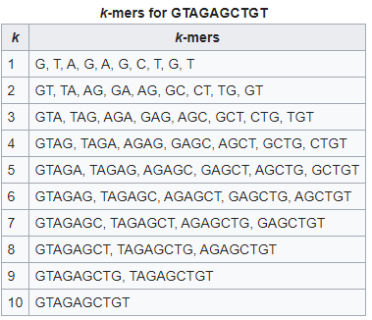
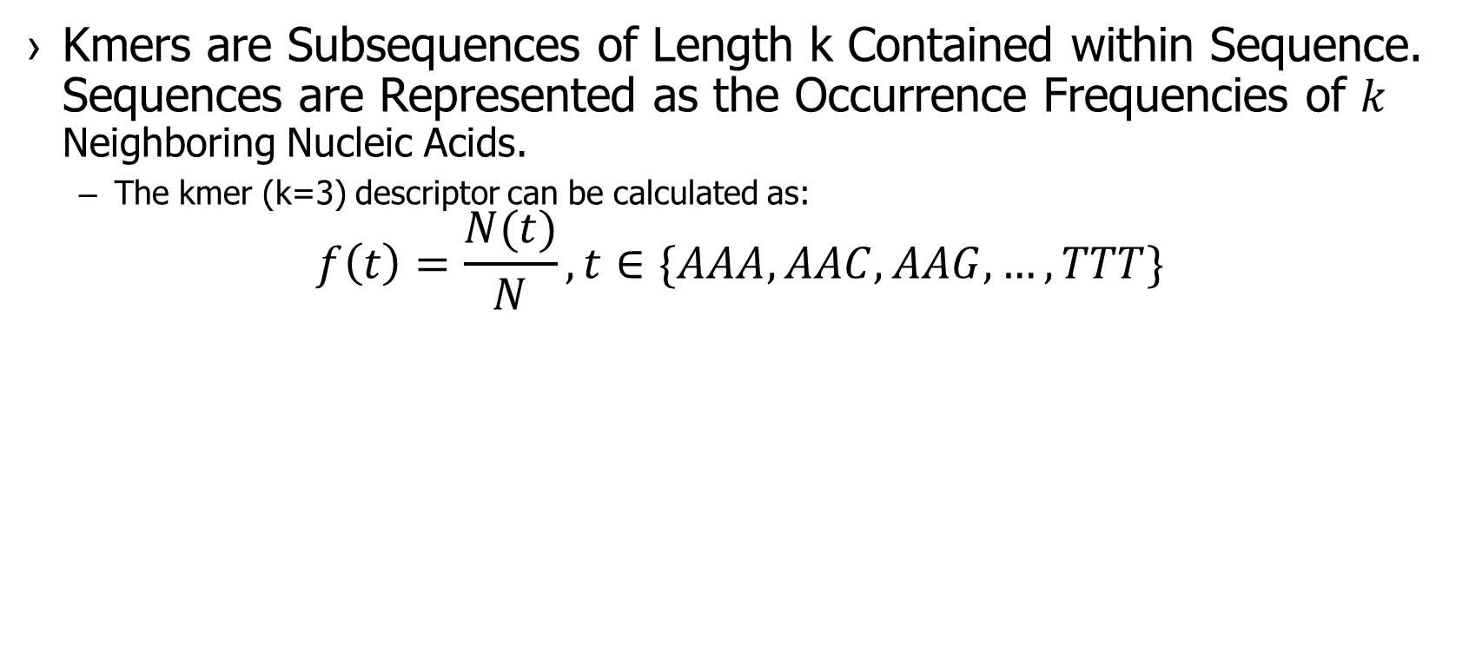
DNA or RNA Feature Extraction - Kmer
Kmers are Subsequences of Length k Contained within Sequence. Sequences are Represented as the Occurrence Frequencies of $k$ Neighboring Nucleic Acids.
The kmer (k=3) descriptor can be calculated as:
$$f\left(t\right)=\frac{N(t)}{N},t∈\{AAA,AAC,AAG,…,TTT\}$$
Notes:
For Kmer descriptor, the DNA sequences are represented as the occurrence frequencies of neighboring nucleic acids. The Kmer (k=3) descriptor can be calculated as:

Slide 12
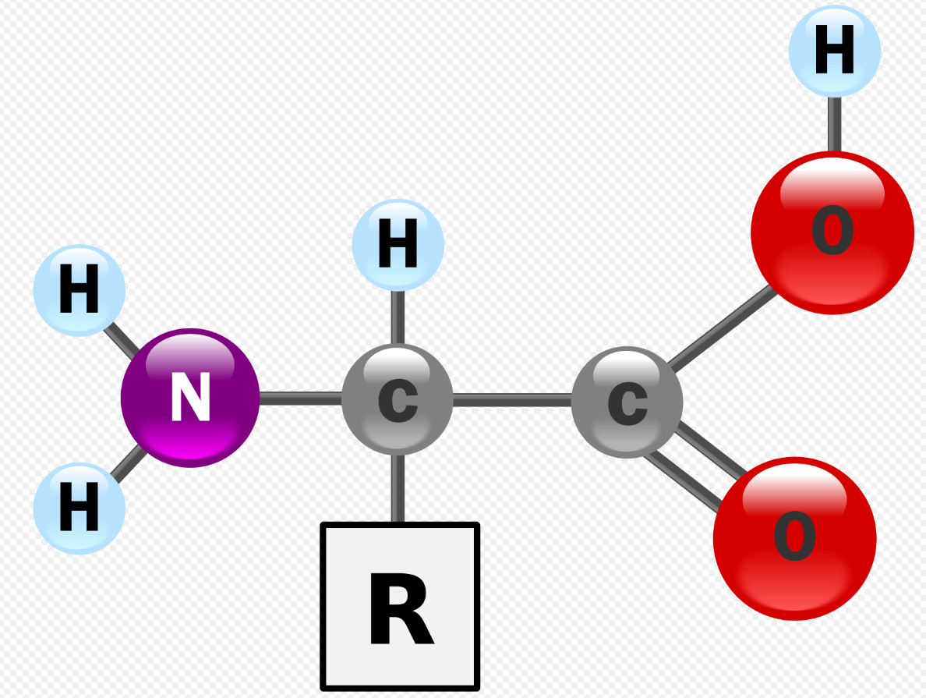
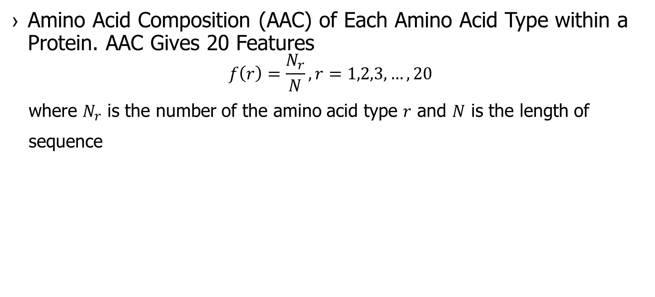
Protein Feature Extraction - AAC
Amino Acid Composition (AAC) of Each Amino Acid Type within a Protein. AAC Gives 20 Features
$$f\left(r\right)=\frac{N_{r}}{N}, r=1,2,3,…,20$$
where $N_{r}$ is the number of the amino acid type $r$ and $N$ is the length of
sequence
Notes:
The structure of an alpha amino acid in its un-ionized form. Twenty of the proteinogenic amino acids are encoded directly by triplet codons in the genetic code and are known as "standard" amino acids.

Slide 13
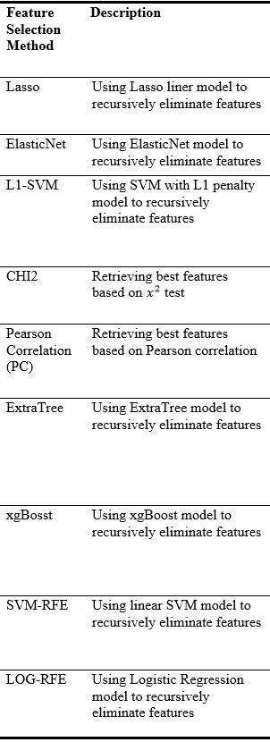
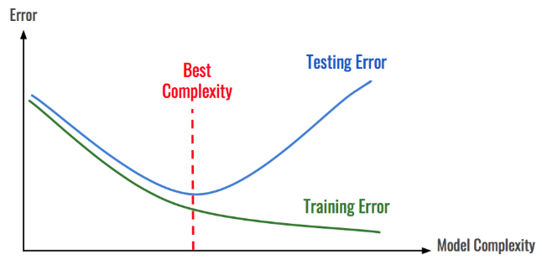
Feature Selection
Extracted feature vectors often show high dimensionality
Selecting those features that contribute most to predictions can
Reduce overfitting
Significantly reduce training time for model construction
Remove noisy features to improve performance of models
20 Feature Selection Methods

Slide 14
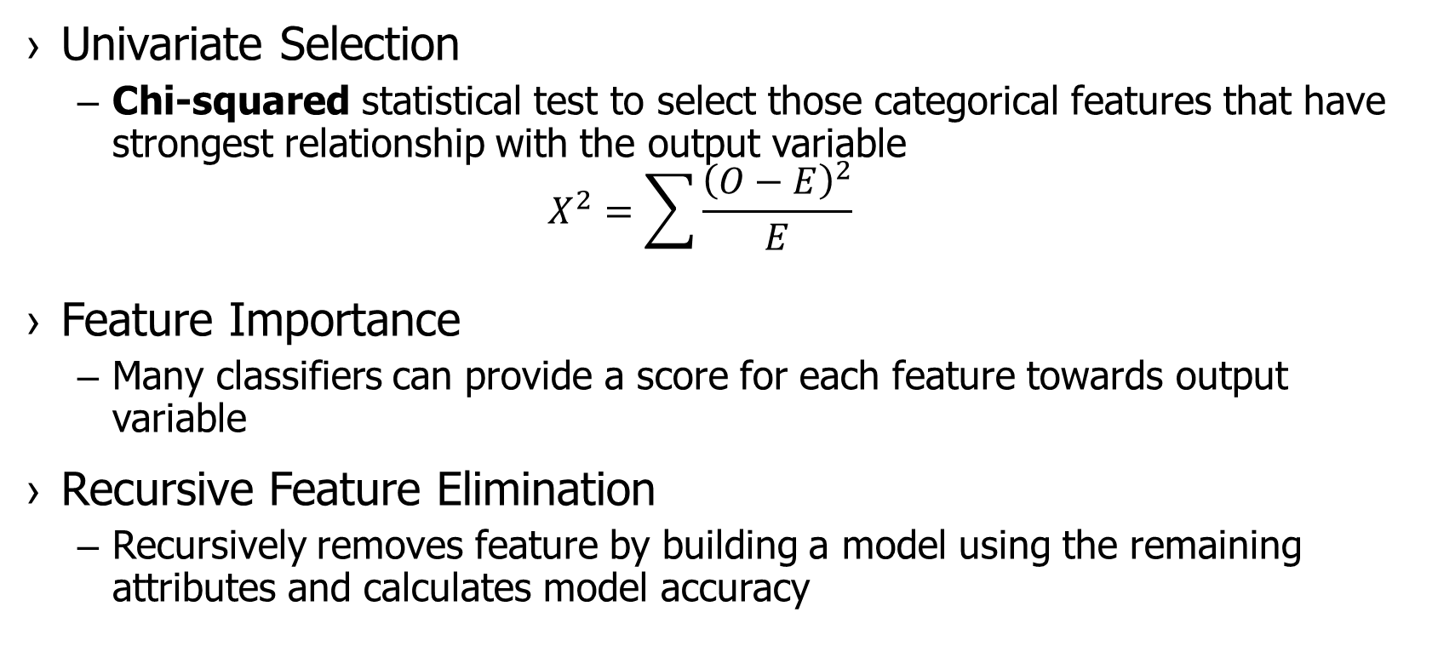
Feature Selection Methods
Univariate Selection
Chi-squared statistical test to select those categorical features that have strongest relationship with the output variable
$$X^{2}=\sum{\frac{{\left(O−E\right)}^{2}}{E}}$$
Feature Importance
Many classifiers can provide a score for each feature towards output variable
Recursive Feature Elimination
Recursively removes feature by building a model using the remaining attributes and calculates model accuracy
Notes:
O is the observed frequency, E is the expected frequency if no relationship between the variables. Chi2 observed in the data and what would be expected if there was truly no relationship between the variables. We calculate Chi-square between each feature and the target and select the desired number of features with best Chi-square scores

Slide 15
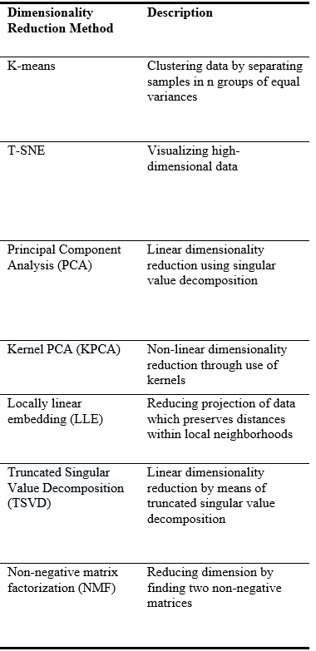
Dimensionality Reduction
Reducing High Dimensionality Data to Low Dimension Based on Data Itself (Unsupervised)
Clustering method
Dimension reduction
For Extremely High-dimension Feature Vectors (Protein)
Reducing data preparation time for modeling
16 Dimensionality Reduction Methods
Notes:
O is the observed frequency, E is the expected frequency if no relationship between the variables. Chi2 observed in the data and what would be expected if there was truly no relationship between the variables. We calculate Chi-square between each feature and the target and select the desired number of features with best Chi-square scores

Slide 16
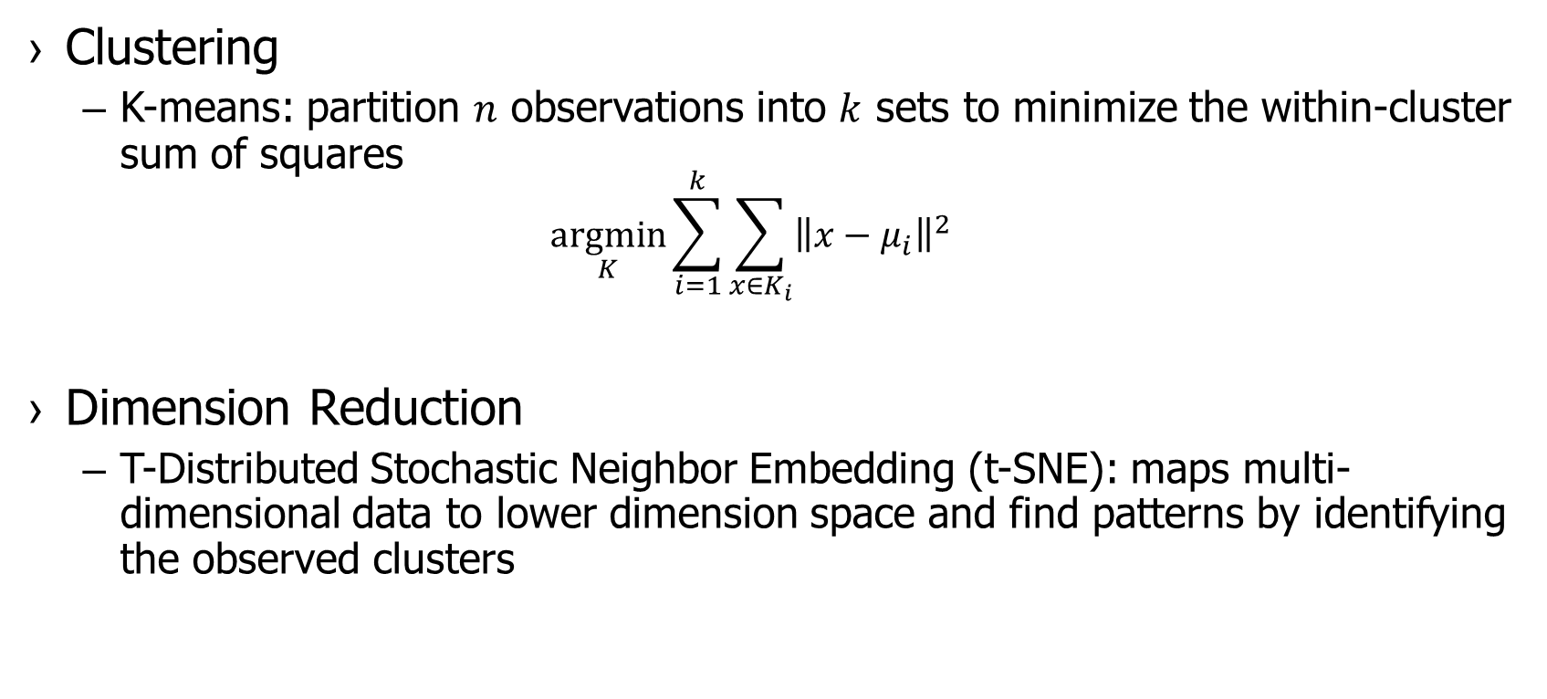
Dimensionality Reduction Method
Clustering
K-means: partition $n$ observations into $k$ sets to minimize the within-cluster sum of squares
$$\underset{K}{argmin}{\sum_{i=1}^{k}{\sum_{x∈K_{i}}{{\left\|x−μ_{i}\right\|}^{2}}}}$$
Dimension Reduction
T-Distributed Stochastic Neighbor Embedding (t-SNE): maps multi-dimensional data to lower dimension space and find patterns by identifying the observed clusters
Notes:
K-MEANS: where μ_{i} is the mean of points in Ki
TSNE; The algorithms starts by calculating the probability of similarity of points in high-dimensional space and calculating the probability of similarity of points in the corresponding low-dimensional space. then tries to minimize the difference between these conditional probabilities (or similarities) in higher-dimensional and lower-dimensional space for a perfect representation of data points in lower-dimensional space.

Slide 17
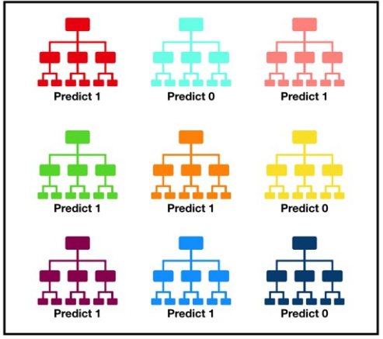
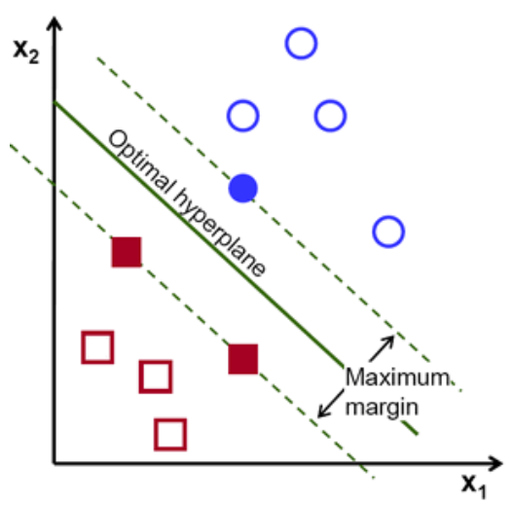
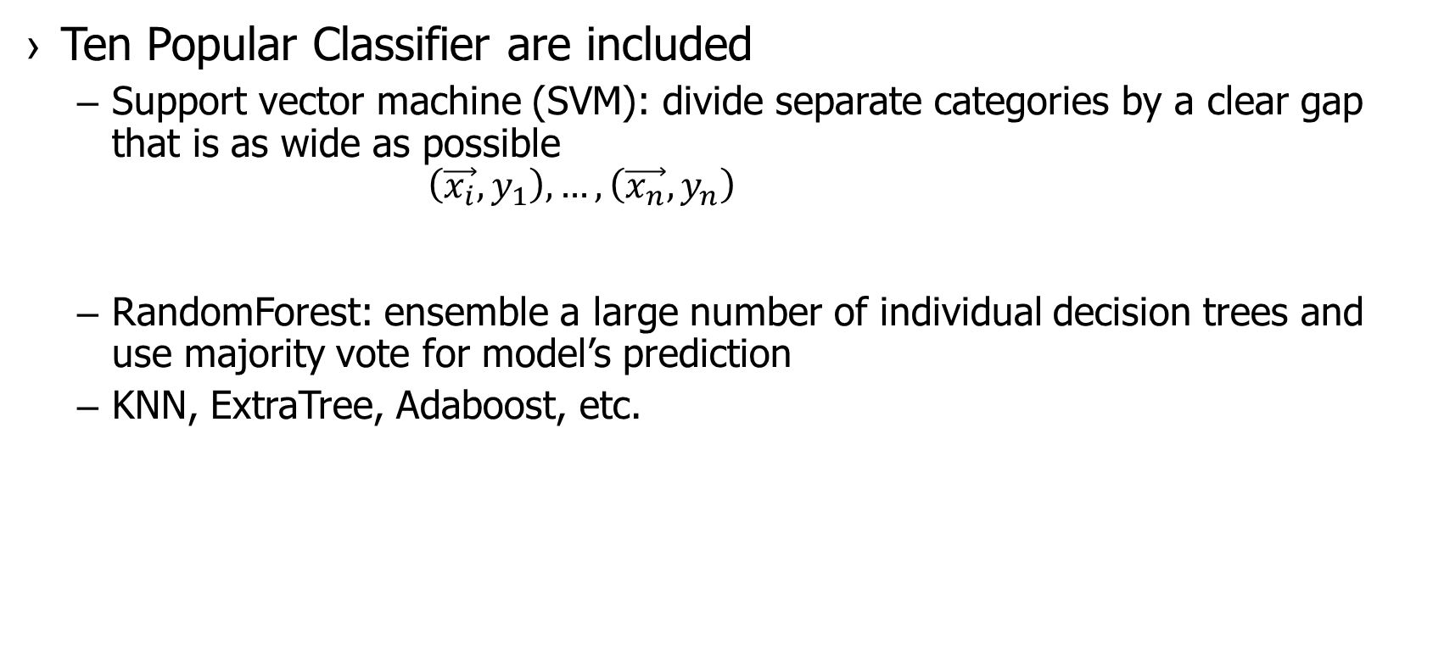
Model Construction
Ten Popular Classifier are included
Support vector machine (SVM): divide separate categories by a clear gap that is as wide as possible
$$\left(\vec{x_{i}},y_{1}\right),…,\left(\vec{x_{n}},y_{n}\right)$$
RandomForest: ensemble a large number of individual decision trees and use majority vote for model’s prediction
KNN, ExtraTree, Adaboost, etc.

Slide 18
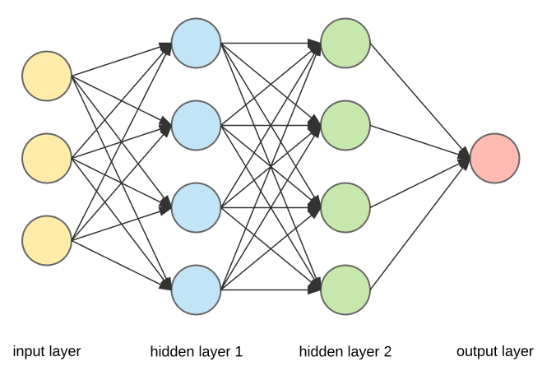
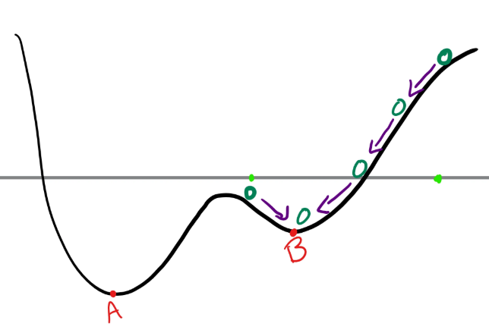
Deep Learning Classification
Three Neural Network Classifier are Included
Artificial neural network are inspired by biological neural network
Notes:
O is the observed frequency, E is the expected frequency if no relationship between the variables. Chi2 observed in the data and what would be expected if there was truly no relationship between the variables. We calculate Chi-square between each feature and the target and select the desired number of features with best Chi-square scores

Slide 19
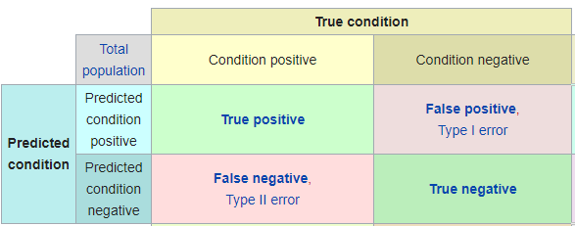
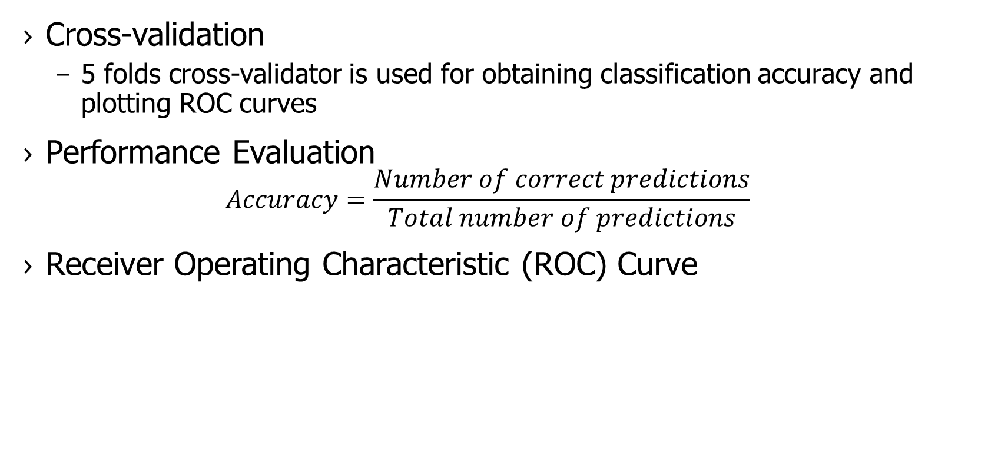
Model Evaluation
Cross-validation
5 folds cross-validator is used for obtaining classification accuracy and plotting ROC curves
Performance Evaluation
$$Accuracy=\frac{Number of correct predictions}{Total number of predictions}$$
Receiver Operating Characteristic (ROC) Curve
Notes:
Receiver operating characteristic curve plot the true positive rate against the false positive rate at various threshold settings

Slide 20
ALLFEATURE
Notes:
O is the observed frequency, E is the expected frequency if no relationship between the variables. Chi2 observed in the data and what would be expected if there was truly no relationship between the variables. We calculate Chi-square between each feature and the target and select the desired number of features with best Chi-square scores

Slide 21
Prediction Task of DNA Sequencing
DNA Enhancers Prediction
DNA enhancers are important for analyzing gene expression
The dataset contains 1484 enhancer samples and 1484 non-enhancer samples
Feature Extraction
PSTNP, RCKmer, PseDNC, TNC and MonoKGap
Feature Selection
All 20 feature selection methods
Notes:
five feature extraction methods to construct initial feature vectors. Multi-information fusion can represent more effective information of DNA sequences

Slide 22
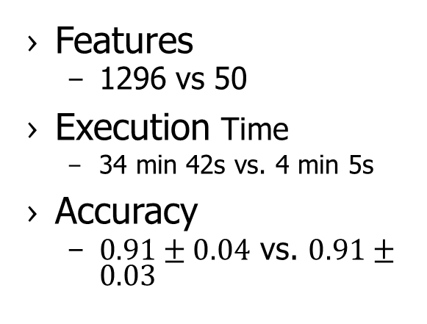
DNA Prediction Results with ExtraTree Feature Selection Method
Features
1296 vs 50
Execution Time
34 min 42s vs. 4 min 5s
Accuracy
$0.91±0.04$ vs. $0.91±0.03$

Slide 23
Prediction Task of RNA Sequencing
RNA N6-methyladenine (6mA) Sites Prediction
6mA refers to methylation of adenosine nucleotide acid at nitrogen-6 position. It is important for splicing events, mRNA exporting, nascent mRNA synthesis, nuclear translocation, etc
Dataset contains 2614 sequences, 1307 represents true methyladenoisne sites
Feature Extraction
Psednc, PSTNP, Kmer, binary and DNC
Feature Selection
All 20 feature selection methods
Notes:
five feature extraction methods to construct initial feature vectors. Multi-information fusion can represent more effective information of RNA sequences

Slide 24
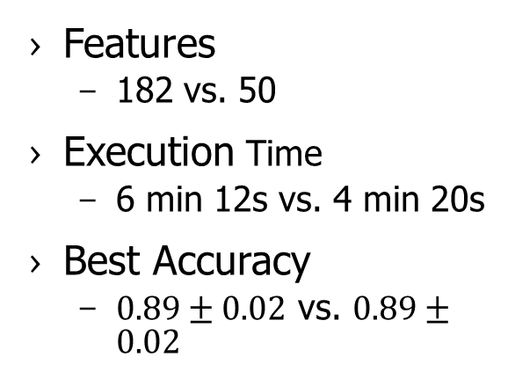
RNA Prediction Results with ReliefF Feature Selection Method
Features
182 vs. 50
Execution Time
6 min 12s vs. 4 min 20s
Best Accuracy
$0.89±0.02$ vs. $0.89±0.02$

Slide 25
Prediction Task of Protein Sequencing
Protein-protein Interactions (PPIs) based on S. cerevisae
Understand protein function and construct interactome
Include 5594 PPIs samples and 5594 non-PPIs samples
Feature Extraction
CTDC, CTDT, CTDD, EBGW, Geary, pseAAC, psePSSM, abPSSM
Feature Selection
All 20 feature selection methods
Notes:
five feature extraction methods to construct initial feature vectors. Multi-information fusion can represent more effective information of RNA sequences

Slide 26
RNA Prediction Results with ReliefF Feature Selection Method
Features
182 vs. 50
Execution Time
6 min 12s vs. 4 min 20s
Best Accuracy
$0.89±0.02$ vs. $0.89±0.02$

Slide 27
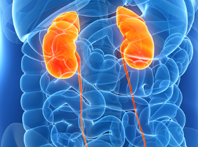
Tool Development of EMR Data Analysis
EMR Data are Extracted from Sanford Health, Sioux Falls, SD
120,495 patients aged from 20 to 80
Estimated Glomerular Filtration Rate (eGFR) is contained in EMR
Stage of chronic kidney disease (CKD) is defined by eGFR
CKD can be predicted if future eGFR can be estimated
Early identification of CKD have potential to
Reduce number of patients progressing to end stage renal disease
Lower mortality rate and healthcare costs

Slide 28

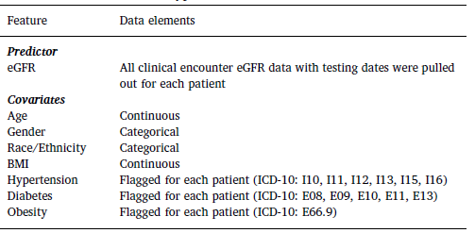
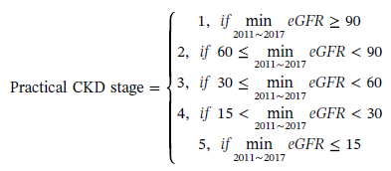
Predictor Selection
EMR data are mixture data
eGFR data are unbalanced data

Slide 29
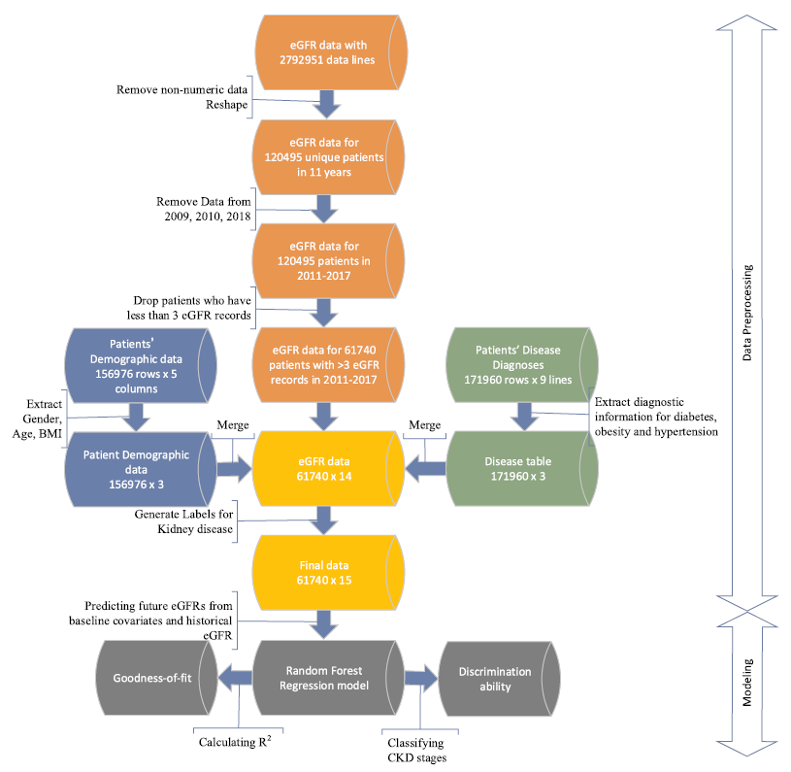
Data Preprocessing

Slide 30
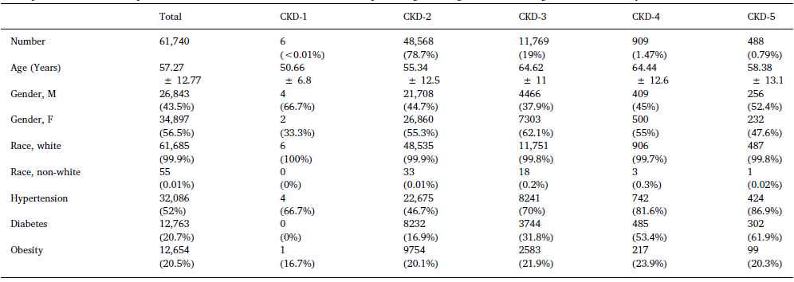
Data Summary

Slide 31
eGFR Prediction Model Construction with Random Forest Regression
61,740 Unique patients have at least three eGFR value
Model for Predicting Year of 2015
At least two eGFR recorded between 2011-2014
Model for Predicting Year of 2016
At least two eGFR recorded between 2011-2015
Model for Predicting Year of 2017
At least two eGFR recorded between 2011-2016
Other Year’s eGFR Values were Imputed and Filled by Median eGFR Value of Each Patient

Slide 32
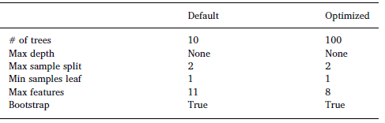
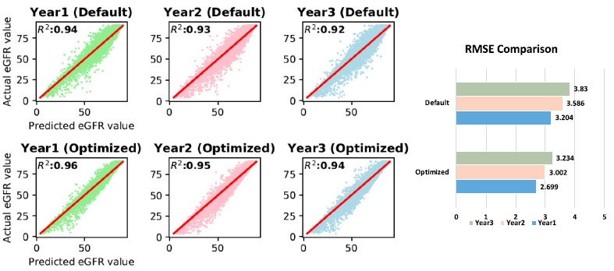
eGFR Prediction with Random Forest Regression

Slide 33
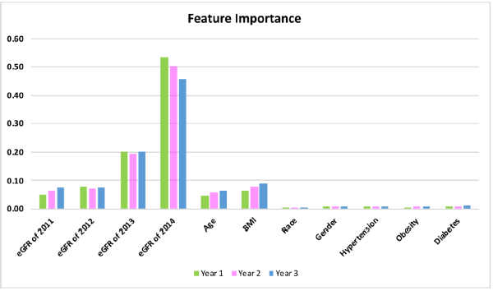
Feature Importance
eGFR Values from Prior Year are the Most Important Feature

Slide 34
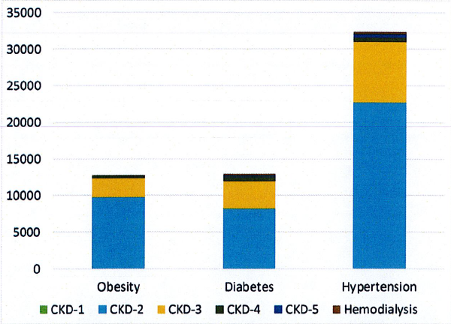
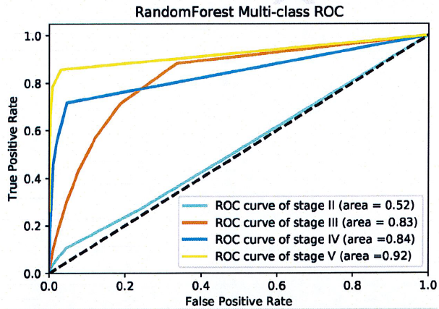
Collaborative Efforts: Chronic Kidney Disease in Agricultural Communities
Left: Distribution of chronic kidney diseases stages within obesity, diabetes, and hypertension.
Right: Classification of chronic kidney disease stages using Random Forest
Notes:
With this observational cohort (n=120,495 study subjects), 56% of the study subjects were female. Race distribution was similar to general distribution in the upper Midwest.

Slide 35
Collaborative Efforts: GeneQC
A Machine Learning Based Tools for Mapping Uncertainty Analysis and Gene Expression Estimation
Notes:
Most RNA-seq studies perform read alignment without much concern for the quality of the alignment results, assuming them to be of sufficient quality. However, our investigation has shown that mapping uncertainty is a prominent issue with the quality of alignment results. We tested 95 datasets the total size about 2T. Each dataset was aligned using HISAT2, against the appropriate reference genome. Alignment statistics were collected or calculated from the HISAT2 output file. It was determined that an average of 22% of all reads were ambiguously aligned in each of the seven distinct plant and animal species. Just as most RNA-seq pipelines use some quality control method for raw reads, a quality control process for read alignment must be included to verify the reliability of mapping results. Therefore, we developed this alignment control tools. In GeneQC, we extract usable features from two genetic levels, genomic and transcriptomic. These three levels of information are combined using linear modeling to develop a distinct score, referred to as the D-score, to provide a clear measure of the level of mapping uncertainty for each annotated gene for a particular species. Additionally, mixture model distributions are used to determine categorizations for the mapping uncertainty and provide recommendations for which genetic expression estimates are reliable following the read alignment step.

Slide 36
Collaborative Efforts: Glycine Max RNA-Seq Analysis
Comparison of Gene Expression
Two Root Nodule Tissues in Soybean: ENOD2 vs. ENOD40
Four time points
3 replicates for each tissues
24 single-end samples
Two Samples in Soybean: 2COLOR vs. STTM160
Four treatments: 2COLOR MOCK, 2COLOR AUX, STTM160 MOCK and STTM160 AUX
Five replicates
80 single-end samples
Three Pipelines:
RNAseq -> HISAT2 -> HTSEQ -> DEseq2
RNAseq -> HISAT2 -> HTSEQ -> edgeR
RNAseq -> HISAT2 -> StringTie -> Ballgown
Notes:
Glycine Max

Slide 37
Collaborative Efforts: scRNA-seq Cell Type Prediction
Comparing the Accuracy and Goodness in Predicting Cell Types among Six Pipeline
Data: 15 scRNA-Seq Datasets with Cells Ranging from 49 to 3005 and Genes from 10,000 to 40,000 including Two 10X Data
Tools: SC3, SCENIC, SEURAT, MONOCLE, BACKSPIN, SINCERA
Results: Seurat is the Most Powerful Tool with Highest Prediction Scores
Notes:
One of my collaborative project was to use different scRNA-Seq analytical tools to test the their cell type prediction. I helped the team by learning and testing six single-cell integrative tools including SC3, SCENIC, Seurat, Monocle, BackSPIN, and Sincera.

Slide 38
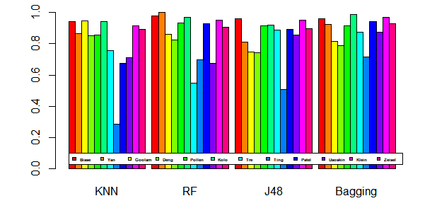
Collaborative Efforts: Cell Type Classification
Four Supervised Machine Learning Methods are Tested for Cell Type Classification based on 12 scRNA-seq Dataset
TP rate of four classification methods based on expression data

Slide 39
Acknowledgments
Committee Members:
Dr. Xijin Ge, Dr. Qin Ma, Dr. Rhoda Burrows
Research Collaborators:
Dr. Yu Bin, Dr. Jing Zhao, Dr. Russell Wilke, Cheng Chen
Lab Members:
Dr. Adam McDermaid, Runan Yao, Anjun Ma, Juan Xie, Yiran Zhang, Cankun Wang, Minxuan Sun
Notes:
One of my collaborative project was to use different scRNA-Seq analytical tools to test the their cell type prediction. I helped the team by learning and testing six single-cell integrative tools including SC3, SCENIC, Seurat, Monocle, BackSPIN, and Sincera.

Slide 40
THANK YOU!

